Slide 1
Using API Data for Scholarly Research (FOR librARIANs)
Mark Eaton
Reader Services Librarian
Kingsborough Community College

Slide 2
* disclaimer

Slide 3
Application Programming Interface (API)
A set of software facilities that enable programmers to develop programs which interact with the software that provides the interface.
(A somewhat standard definition)
from Ince, Darrel. "API." A Dictionary of the Internet, 2013.

Slide 4
Application Programming Interface (API)
A service that makes machine-readable data available to librarians (or others) who can write programs to access that data.
(a definition I made up for this workshop)

Slide 5
http://www.kbcc.cuny.edu

Slide 6
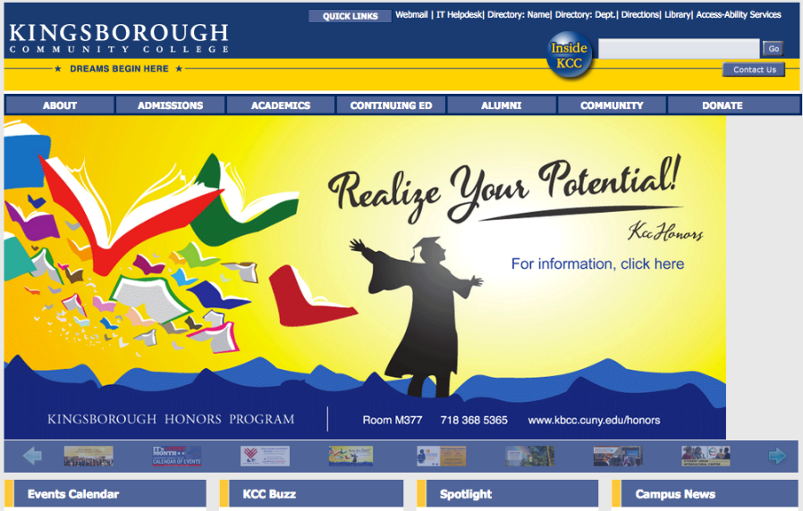

Slide 7
http://onesearch.cuny.edu/PrimoWebServices/xservice/search/brief?&institution=KB&query=any,contains,cuny&loc=adaptor,primo_central_multiple_fe&json=true

Slide 8
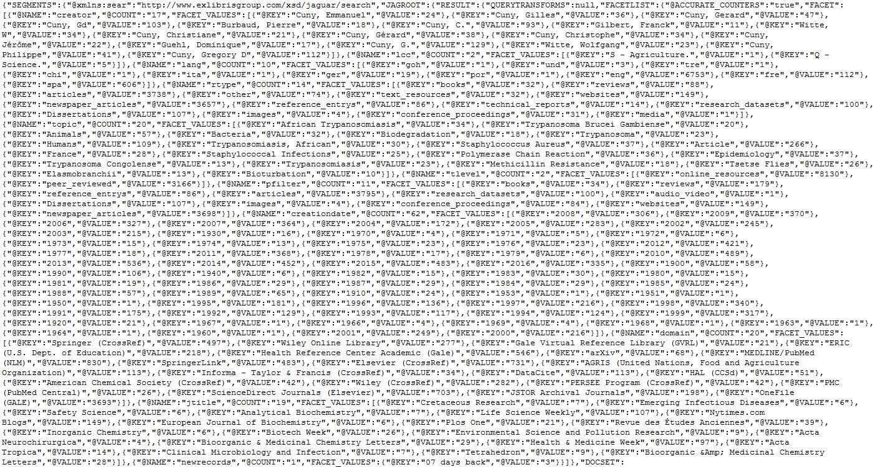

Slide 9
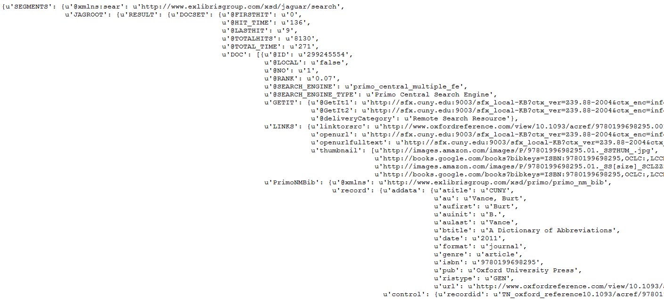

Slide 10
http://onesearch.cuny.edu/PrimoWebServices/xservice/search/brief?&institution=KB&query=any,contains,cuny&loc=adaptor,primo_central_multiple_fe&json=true
* This is a GET Request *

Slide 11
XML
vs.
JSON

Slide 12
http://is.gd/apiday

Slide 13
http://is.gd/apidocs

Slide 14
http://is.gd/oclcapi

